Slide 1
Data Warehousing and On-line Analytical Processing
Data Warehouse: Basic Concepts
Data Warehouse Modeling: Data Cube and OLAP
Data Warehouse Implementation
Summary

Slide 2
What is a Data Warehouse?
Defined in many different ways, but not rigorously
Support decision
Maintained Separately
Information processing
“A data warehouse is a subject-oriented, integrated, time-variant, and nonvolatile collection of data in support of management’s decision-making process.”—W. H. Inmon
Data warehousing:
The process of constructing and using data warehouses
Notes:
DW provides architectures and tools for business executives to systematically organize, understand, and use their data to make decisions.
William Inmon is an American computer scientist. He is recognized as the father of the data warehouse. He coined the term data warehouse in 1990 and is considered the father of the $28 billion industry. He has worked for American Management Systems before 1991.
He founded two companies Prism Solutions, Pine Cone Systems 91-99.
In 1999, he created the Corporate Information Factory Web site to educate professionals and decision makers about data warehousing and the Corporate Information Factory.
In 2007, he was named by Computerworld as one of the ten people that most influenced the first 40 years of the computer industry: Whitfield Diffie (information security, Turing Award, Keynote Speaker in KDD’16).
Two books. "Building the Data Warehouse" (1992, with later editions) and "DW 2.0: The Architecture for the Next Generation of Data Warehousing" (2008).
Four key features - distinguish DW from other data repository systems (relational database systems, transaction processing systems, file systems). Will introduce them one by one.
1. To support decision support 2. Integrate different sources 3. Integrate data of different time
4. Nonvolatile: store on disks, permanently able to be visited, though you shut down the machines

Slide 3
Data Warehouse—Subject-Oriented
Help make decisions
A simple and concise view (modeling and analysis)
Not details (transaction processing)
Organizing around major subjects, such as customer, product, sales
Excluding data that are not useful in the decision support process
Notes:
Major subjects. ER (entity-relationship) model: courses, students and course-student relationships. Super large. Often the ER model may have 50-60 kinds of relationships.
For a real company it is too difficult to count the number of entity relationships in the ER model.
If you want to analyze the data, make the decision, you cannot take such too complicated data. You should take one subject.
Take customer. Take sales (take only the relationships from sales to other entities: states, dates…).

Slide 4
Data Warehouse—Integrated
Integrating Multiple, heterogeneous sources
Ex. relational databases, flat files, on-line transaction records
Consistency
Data cleaning and data integration techniques are applied.
Ex. Hotel price: differences on currency, tax, breakfast covered, and parking
When data is moved to the warehouse, it is converted
Notes:
Take Walmart as another example: different currencies in different countries, different tax rates, different items sold in different stores. Lots of work on data cleaning.

Slide 5
Data Warehouse—Time Variant
Data Warehouse | Operational Database
Long time horizon (e.g., past 5-10 years) | current value data
Contains an element of time, explicitly or implicitly | data may or may not contain “time element”
Notes:
Operational database: you are working on the database (request, response, select, insert). When you request your balance of your bank account, the system will visit the operational database and return you the current data (balance). It’s fast.
When you want to analyze the data, you want to take the historical petabytes of data. The big data have to be managed in DW.
Time Variant: adding one more dimension, the time dimension, to the database → DW. This is the major difference between operational database and DW.

Slide 6
Data Warehouse—Nonvolatile
Independence – A physically separate store
Static – No data management (updates, transaction processing, recovery, and concurrency control mechanisms)
Requires only two operations in data accessing:
initial loading of data and access of data
Notes:
No matter what happened, you turn on the system. The data are still there. You separately store the data in a physical space from the operational environment.
When you are operating the database, the DW doesn’t have to follow every step/operation.
Operational databases have “lock” to control the visits when you deposit or draw money from your bank account. But DW doesn’t have the lock. It has delay from the operational database.
It usually takes hours or days to load/update the data or sync with the operational database.

Slide 7
Why a Separate Data Warehouse?
Different functions and different data:
missing data: Decision support requires historical data which operational DBs do not typically maintain
data consolidation: DS requires consolidation (aggregation, summarization) of data from heterogeneous sources
data quality: different sources typically use inconsistent data representations, codes and formats which have to be reconciled
Note: There are more and more systems which perform OLAP (online analytical processing) analysis directly on relational databases
Notes:
Missing data: You cannot find historical data from operational databases.
Data quality: DW requires lots of data preprocessing (cleaning, aggregation…)

Slide 8
OLTP vs. OLAP
OLTP: Online transactional processing
DBMS operations
Query and transactional processing
OLAP: Online analytical processing
Data warehouse operations
Drilling, slicing, dicing, etc.
Notes:
OLTP (transactional): manage the operational database – database management system operations. Very popular in the industry.
OLAP: support DW operations. Another industry standard.
Who use OLTP/OLAP?
Knowledge worker: mine the patterns, prediction, decisions.
Why use it? How the DB was designed?
Data structure? How the users use it?
What is the unit of work? ...
Metric: evaluate the performance (high or low)

Slide 9
Data Warehouse: A Multi-Tiered Architecture
Top Tier: Front-End Tools
Middle Tier: OLAP Server
Bottom Tier: Data Warehouse Server
Data
Notes:
DW bridges the data from operational databases and the query, report and analysis (front-end tools) of decision makers.
Point to the “data marts (for different departments)”.
S1: Split DW into data marts for specific, selected groups. (projection)
Eg. DW: for Holiday Inn.
Data marts: IA’s Holiday Inn; Advertisement and promotions of Holiday Inn.
Data marts are usually implemented on low-cost departmental servers.
S2: First build data marts independently and then merge them.

Slide 10
Extraction, Transformation, and Loading (ETL)
Data extraction
get data from multiple, heterogeneous, and external sources
Data cleaning
detect errors in the data and rectify them when possible
Data transformation
convert data from legacy or host format to warehouse format
Load
sort, summarize, consolidate, compute views, check integrity, and build indices and partitions
Refresh
propagate the updates from the data sources to the warehouse

Slide 11
Chapter 4: Data Warehousing and On-line Analytical Processing
Data Warehouse: Basic Concepts
Data Warehouse Modeling: Data Cube and OLAP
Data Warehouse Implementation
Summary

Slide 12
From Tables and Spreadsheets to Data Cubes
A data warehouse is based on a multidimensional data model which views data in the form of a data cube
Main function is to provide summarizations of the data
E.g., summarize the units or dollars sold at a particular store over a particular time period
Can compute summarizations online (as they are requested)
Can be very slow
Better to pre-calculate some summarizations

Slide 13
A Sample Data Cube
Date
Total annual sales
of TVs in U.S.A.
1Qtr
2Qtr
3Qtr
4Qtr
sum
Product
TV
PC
U.S.A
VCR
sum
Canada
Country
Mexico
sum
All, All, All
Notes:
This example has three dimensions. It can have more dimensions in real applications.

Slide 14
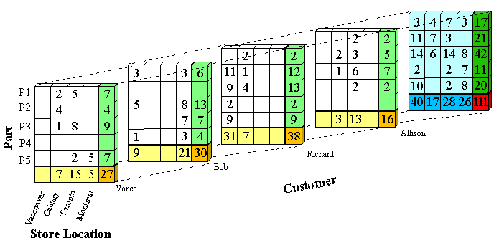
Product
4 Qtr
3 Qtr
2 Qtr
Date
1 Qtr
Mexico
Canada
Cuba
U.S.A
Country
Notes:
This representation works better for dense arrays(i.e., not too many empty entries).
If the array is sparse, we can use the following method to record the information.

Slide 15
Data Cube: A Lattice of Cuboids
all
0-D (apex) cuboid
time
item
location
supplier
1-D cuboids
time,location
item,location
location,supplier
time,item
2-D cuboids
time,supplier
item,supplier
time,location,supplier
3-D cuboids
time,item,location
time,item,supplier
item,location,supplier
4-D (base) cuboid
time, item, location, supplier

Slide 16
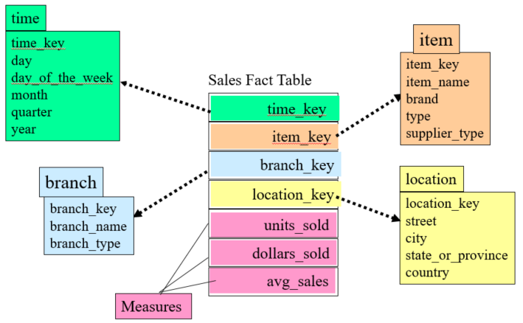
Design of Data Warehouses
Dimension tables, such as item (item_name, brand, type), or time(day, week, month, quarter, year)
Fact table contains measures (such as dollars_sold) and keys to each of the related dimension tables
Different schema exist
Star
Snowflake
Fact constellation
Notes:
Pink: measures, usually in real values
Non-pink: dimensions

Slide 17
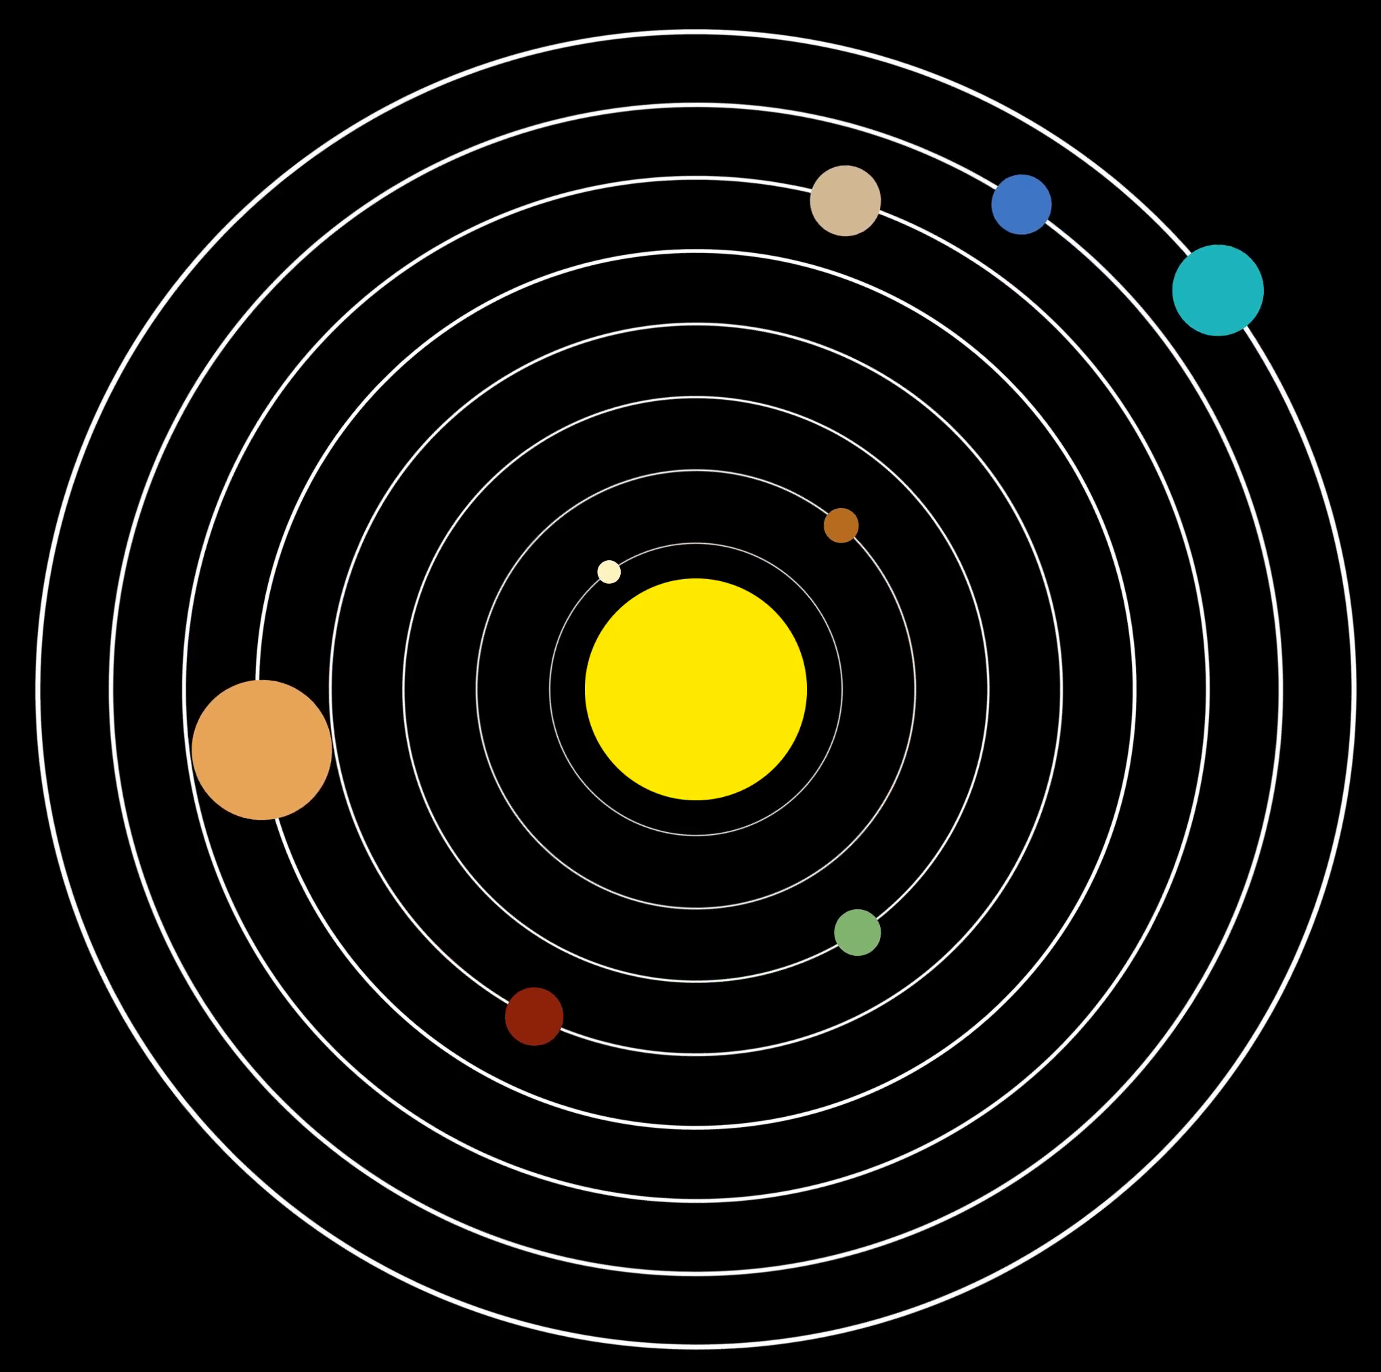
Star Schema: An Example
A fact table in the middle connected to a set of dimension tables ​
time
time_key
day
day_of_the_week
month
quarter
year
item
item_key
item_name
brand
type
supplier_type
Sales Fact Table
time_key
item_key
branch_key
branch
location
location_key
branch_key
branch_name
branch_type
location_key
street
city
state_or_province
country
units_sold
dollars_sold
avg_sales
Measures
Notes:
Solar system image from https://d2v9y0dukr6mq2.cloudfront.net/video/thumbnail/0kjHIH6/simple-vector-illustration-style-of-the-solar-system-with-planets-orbiting-the-sun-for-hud-or-other-screens-and-illustrations_nksj6hdfg__F0000.png
In this example:
3 measures
4 dimensional keys: every dimension has different levels

Slide 18

Snowflake Schema: An Example
A refinement of star schema where some dimensional hierarchy is normalized into a set of smaller dimension tables, forming a shape similar to snowflake​
time
item
time_key
day
day_of_the_week
month
quarter
year
item_key
item_name
brand
type
supplier_key
supplier
Sales Fact Table
supplier_key
supplier_type
time_key
item_key
branch_key
branch
location
location_key
location_key
street
city_key
branch_key
branch_name
branch_type
units_sold
dollars_sold
city
city_key
city
state_or_province
country
avg_sales
Measures
Notes:
Snowflake image from https://cdn.shopify.com/s/files/1/2009/8293/products/S1603.jpg?v=1515429539
In this example, location table is “normalized” with introducing the city_key.
Snowflake schema: save storage cost (you have to link the tables/relations when you compute)
Star schema: save computing cost (some companies still use star schema, not snowflake schema)

Slide 19

Fact Constellation: An Example
time
time_key
day
day_of_the_week
month
quarter
year
item
Shipping Fact Table
Multiple fact tables share dimension tables, viewed as a collection of stars, therefore called galaxy schema or fact constellation ​
item_key
item_name
brand
type
supplier_type
Sales Fact Table
time_key
time_key
item_key
shipper_key
item_key
branch_key
from_location
branch
location_key
location
to_location
branch_key
branch_name
branch_type
units_sold
location_key
street
city
province_or_state
country
dollars_cost
dollars_sold
units_shipped
avg_sales
shipper
Measures
shipper_key
shipper_name
location_key
shipper_type
Notes:
Constellation image from https://www.worldatlas.com/r/w728-h425-c728x425/upload/ea/02/6d/shutterstock-560485789.jpg
Sales and Shipping tables can share items, locations, time tables.

Slide 20
A Concept Hierarchy for a Dimension (location)
all
all
region
Europe
...
North_America
country
Germany
...
Spain
Canada
...
Mexico
city
Frankfurt
...
Vancouver
...
Toronto
office
L. Chan
...
M. Wind
Notes:
Levels and values of a dimension
Q1: How to construct the concept hierarchy from structured data (Web Tables)?
Q2: How to … from (unstructured) text data?

Slide 21
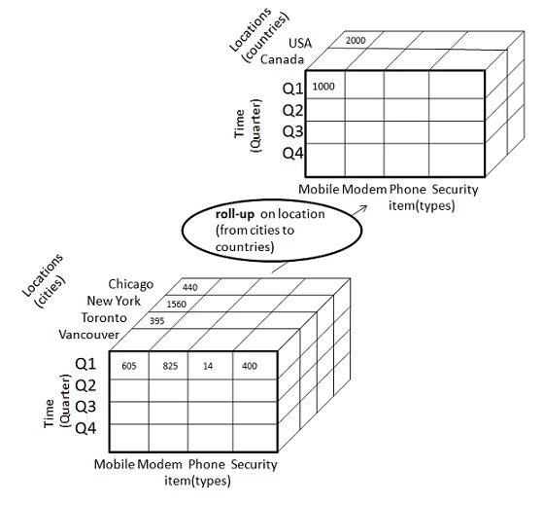
Roll up & Drill down
Roll up (drill-up): summarize data
by climbing up hierarchy or by dimension reduction
Roll up
Phone PC Watch earphone
Product(types)
Drill down
Drill down (roll down): reverse of roll-up
from higher level summary to lower level summary or detailed data, or introducing new dimensions
Phone PC Watch earphone
Product(types)

Slide 22
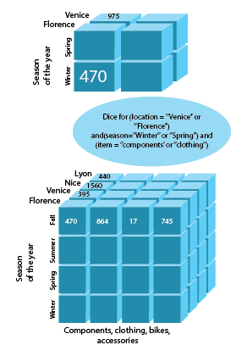
Dice and Slice
Vancouver
Slice for
(Location = "Vancouver")
Locations
Q1
Q2
Q3
Q4
Chicago
New York
Toronto
Vancouver
Time
Q1
Q2
Q3
Q4
Time
Phone PC Watch earphone
Product(types)
Phone PC Watch earphone
Product(types)
Toronto
Vancouver
Dice for
(Location = "Toronto" or "Vancouver") and (Time = "Q2" or "Q1") and (Product = "Phone" or "PC")
Q2
Q1
Time
Phone PC
Product(types)

Slide 23
Chapter 4: Data Warehousing and On-line Analytical Processing
Data Warehouse: Basic Concepts
Data Warehouse Modeling: Data Cube and OLAP
Data Warehouse Implementation
Summary

Slide 24
Efficient Data Cube Computation
If I have n dimensions, each with L_{i} levels, how many cuboids are needed to preprocess all?
Calculating all cuboids is costly in computation and time.
How to decide which cuboid be pre-calculated (Materialization)?
Based on size of data, sharing, access frequency, etc.
Example: I know my users always search by Quarter, so that cuboid should be pre-calculated.
Example: If I pre-calculate days, I can use days as input to Months (30 or 31 days), or weeks (7 days), etc.
Why this formula?
Sector Location Time
Industry Region Year
Category Country Quarter
Product City Month Week
Office Day

Slide 25
The “Compute Cube” Operator
Cube definition and computation in DMQL (Data Mining Query Language)
define cube sales [item, city, year]: sum (sales_in_dollars)
compute cube sales
Transform it into a SQL-like language (with a new operator cube by, introduced by Gray et al.’96)
SELECT item, city, year, SUM (amount)
FROM SALES
CUBE BY item, city, year
Need compute the following Group-Bys (2 ^ 3)
3D Cuboid → (date, product, customer),
2D Cuboid → (date, product),(date, customer), (product, customer),
1D Cuboid → (date), (product), (customer)
0D (Apex) Cuboid → ()
()
(city)
(item)
(year)
(city, item)
(city, year)
(item, year)
(city, item, year)
Notes:
James Nicholas “Jim” Gray (born January 12, 1944; presumed lost at sea January 28, 2007 – 63-year-old; declared deceased May 16, 2012) was an American computer scientist who received the Turing Award in 1998 “for seminal contributions to database and transaction processing research and technical leadership in system implementation.”
“Gone missing” http://research.microsoft.com/en-us/um/people/gray/
Gray pursued his career primarily working as a researcher and software designer at a number of industrial companies, including IBM, Tandem Computers, and DEC. He joined Microsoft in 1995 and was a Technical Fellow for the company.
Jim Gray ICDE’96, DMKD’97
Data cube: A relational aggregation operator generalizing group-by, cross-tab, and sub-totals
“Cube by”: (many) group-bys (+ cross-table + sub-totals)
-----------

Slide 26
Efficient Processing OLAP Queries
Determine which operations should be performed on the available cuboids
Transform drill, roll, etc. into corresponding SQL and/or OLAP operations, e.g., dice = selection + projection
Determine which materialized cuboid(s) should be selected for OLAP op.
Let the query to be processed be on {brand, province_or_state} with the condition “year = 2004”, and there are 4 materialized cuboids available:
1) {year, item_name, city}
2) {year, brand, country}
3) {year, brand, province_or_state}
4) {item_name, province_or_state} where year = 2004
Which should be selected to process the query?

Slide 27
Data Cube: A Lattice of Cuboids
all
0-D(apex) cuboid
time
item
location
supplier
1-D cuboids
time,location
item,location
location,supplier
2-D cuboids
time,item
time,supplier
item,supplier
time,location,supplier
3-D cuboids
time,item,location
time,item,supplier
item,location,supplier
4-D(base) cuboid
time, item, location, supplierc

Slide 28
Data Cube: A Lattice of Cuboids
all
Base vs. aggregate cells
Ancestor vs. descendant cells
Parent vs. child cells
(*,*,*,*)
(*, milk, *, *)
(*, milk, Urbana, *)
(*, milk, Chicago, *)
(9/15, milk, Urbana, *)
(9/15, milk, Urbana, Dairy_land)
time
item
location
supplier
time,item
0-D (agg)
time,location
item,location
location,supplier
time,supplier
item,supplier
1-D (agg)
2-D (agg)
time,item,location
time,location,supplier
time,item,supplier
item,location,supplier
2-D (agg)
3-D (agg)
time, item, location, supplier
4-D (base)

Slide 29
Multi-Way Array Aggregation (MOLAP)
How can I efficiently calculate all group-by cell aggregations? Full cube computation
Fundamental Concept: AB, AC, and BC can be computed from ABC. A, B, and C can be computed from AB/AC/BC.
Common Practice with limited memory: Do not load the entire dimension (in array form) into memory at once. Use Chunks:
http://pages.cs.wisc.edu/~nil/764/DADS/38_zhao97arraybased.pdf - Zhao et al. ‘97

Slide 30
Multi-Way Array Aggregation (MOLAP)
Chunk and store as(chunk_id, offset)
Tells which cells in the chunk have data
Goal: Read chunk only once in memory
BC /AB only once
Example: Student Record Data Warehouse
count(A) > count (B) > count(C)
What is best order to put the chunks in order to calculate the aggregation?
Example:
A: 4000, B: 400, C: 40
Chunk:
1000 x 100 x 10
C
c₃
61
c₂
45
c₁
29
c₀
b₃
13
b₂
9
B
8
52
b₁
5
6
7
36
20
b₀
1
2
3
4
a₀
a₁
a₂
a₃
A

Slide 31
Cube Computation: Multi-Way Array Aggregation (MOLAP)
Scan Order: 1 – 2 – 3 – 4 – 5 – 6 – …
Goal: Fully compute chunk only once
Example:
A: 4000, B: 400, C: 40
Chunk:
1000 x 100 x 10
While we scan through 1..4
One row of AC plane is partially computed
One chunk of BC plane is fully computed (write to file)
One row in AB plane is partially computed
now scan through 5…8
c₃
61
c₂
45
c₁
29
c₀
b₃
13
AB
b₂
9
52
b₁
5
6
7
8
36
20
b₀
1
2
3
4
BC
a₀
a₁
a₂
a₃
AC
Notes:
IJM: Memory size is Ok. Can it be better with another scan order?

Slide 32
Cube Computation: Multi-Way Array Aggregation (MOLAP)
Scan Order: 1 – 2 – 3 – 4 – 5 – 6 – …
Goal: Fully compute chunk only once
Example:
A: 4000, B: 400, C: 40
Chunk:
1000 x 100 x 10
While we scan through 5…8
Same row of AC plane is updated
Another chunk of BC plane is fully computed (reuse the same place in memory)
another row in AB plane is partially computed
Continue on 9…12
Continue on 13…16
c₃
61
c₂
45
c₁
29
c₀
b₃
13
AB
b₂
9
52
b₁
5
6
7
8
36
20
b₀
1
2
3
4
BC
a₀
a₁
a₂
a₃
AC
Notes:
IJM: Memory size is Ok. Can it be better with another scan order?

Slide 33
Cube Computation: Multi-Way Array Aggregation (MOLAP)
Scan Order: 1 – 2 – 3 – 4 – 5 – 6 – …
Goal: Fully compute chunk only once
Example:
A: 4000, B: 400, C: 40
Chunk:
1000 x 100 x 10
While we scan through 13…16
One row of AC plane is fully computed (write to file)
Another chunk of BC plane is fully computed (reuse the same place in memory)
Whole AB plane is partially computed
Memory requirement:
4000 x 10 (AC) + 100 x 10 (BC) + 4000 x 400 (AB) = 1,641,000 units
c₃
61
c₂
45
c₁
29
c₀
b₃
13
AB
b₂
9
52
b₁
5
6
7
8
36
20
b₀
1
2
3
4
BC
a₀
a₁
a₂
a₃
AC
Notes:
IJM: Memory size is Ok. Can it be better with another scan order?

Slide 34
Cube Computation: Multi-Way Array Aggregation (MOLAP)
Dimension Order: 1 – 5 – 9 – 13 – 2 – 6 – …
Example:
A: 4000, B: 400, C: 40
Chunk:
1000 x 100 x 10
c₃
One column of BC plane is fully computed (write to file)
Another chunk of AC plane is fully computed (reuse the same place in memory)
Whole AB plane is partially computed
Memory:
400 x 10 (BC) + 1000 x 10 (AC) + 4000 x 400 (AB)
1,614,000 units
61
c₂
45
c₁
29
c₀
b₃
13
AB
b₂
9
52
b₁
5
6
7
8
36
20
b₀
1
2
3
4
BC
a₀
a₁
a₂
a₃
AC
Notes:
IJM: Memory size is about the same as 1-2-3-4-5-6

Slide 35
Cube Computation: Multi-Way Array Aggregation (MOLAP)
Dimension Order: 1 – 17 – … – 13 – 29 – 45 – 61 …
Example:
A: 4000, B: 400, C: 40
Chunk:
1000 x 100 x 10
One chunk of AB plane
One row of AC plane
One chunk of AB plane
All chunks in BC plane
Memory:
1000 x 40 (AC) + 1000 x 100 (AB) + 400 x 40 (BC)
156,000 units
The best order
See explanation in notebook
c₃
61
c₂
45
c₁
29
c₀
b₃
13
AB
b₂
9
52
b₁
5
6
7
8
36
20
b₀
1
2
3
4
BC
a₀
a₁
a₂
a₃
Entire BC plane
One column of AC plane
AC
Notes:
IJM: Memory size decreases dramatically. Why?

Slide 36
Cube Computation: Multi-Way Array Aggregation (MOLAP)
Main Goal of Multi-Way: Reducing memory and I/O
How?
Keep the smallest plane in main memory
Fetch and compute only one chunk at a time for the largest plane
The planes should be sorted and computed according to their size in ascending order
Suppose A>B>C>…
for a in A: for b in B: for c in C: …
Notes:
IJM: Organized

Slide 37
Cube Computation: Multi-Way Array Aggregation (MOLAP)
Pros and Cons of Multi-Way
Pro: Efficient for computing the full cube for a small number of dimensions
Con: Can not calculate iceberg cube.
i.e: If there are a large number of dimensions, “top-down” computation and iceberg cube computation methods (e.g., BUC) should be used
Notes:
IJM: Organized

Slide 38
Chapter 4: Data Warehousing and On-line Analytical Processing
Data Warehouse: Basic Concepts
Data Warehouse Modeling: Data Cube and OLAP
Data Warehouse Implementation
Summary

Slide 39
Summary
Data warehousing: A multi-dimensional model of a data warehouse
A data cube consists of dimensions & measures
Star schema, snowflake schema, fact constellations
OLAP operations: drilling, rolling, slicing, dicing and pivoting
Data Warehouse Architecture, Design, and Usage
Multi-tiered architecture
Business analysis design framework
Information processing, analytical processing, data mining
Implementation: Efficient computation of data cubes
Partial vs. full vs. no materialization
OLAP query processing
MOLAP

Slide 40
References (I)
S. Agarwal, R. Agrawal, P. M. Deshpande, A. Gupta, J. F. Naughton, R. Ramakrishnan, and S. Sarawagi. On the computation of multidimensional aggregates. VLDB’96
D. Agrawal, A. E. Abbadi, A. Singh, and T. Yurek. Efficient view maintenance in data warehouses. SIGMOD’97
R. Agrawal, A. Gupta, and S. Sarawagi. Modeling multidimensional databases. ICDE’97
S. Chaudhuri and U. Dayal. An overview of data warehousing and OLAP technology. ACM SIGMOD Record, 26:65-74, 1997
J. Gray, et al. Data cube: A relational aggregation operator generalizing group-by, cross-tab and sub-totals. Data Mining and Knowledge Discovery, 1:29-54, 1997.
A. Gupta and I. S. Mumick. Materialized Views: Techniques, Implementations, and Applications. MIT Press, 1999
J. Han. Towards on-line analytical mining in large databases. SIGMOD Record, 1998
V. Harinarayan, A. Rajaraman, and J. D. Ullman. Implementing data cubes efficiently. SIGMOD’96

Slide 41
References (II)
C. Imhoff, N. Galemmo, and J. G. Geiger. Mastering Data Warehouse Design: Relational and Dimensional Techniques. John Wiley, 2003
W. H. Inmon. Building the Data Warehouse. John Wiley, 1996
R. Kimball and M. Ross. The Data Warehouse Toolkit: The Complete Guide to Dimensional Modeling. 2ed. John Wiley, 2002
P. O'Neil and D. Quass. Improved query performance with variant indexes. SIGMOD'97
S. Sarawagi and M. Stonebraker. Efficient organization of large multidimensional arrays. ICDE'94
P. Valduriez. Join indices. ACM Trans. Database Systems, 12:218-246, 1987.
J. Widom. Research problems in data warehousing. CIKM’95.
K. Wu, E. Otoo, and A. Shoshani, Optimal Bitmap Indices with Efficient Compression, ACM Trans. on Database Systems (TODS), 31(1), 2006, pp. 1-38.

